Slide 1
Recognition and Spatial Localization of Objects in 3D Space
Dingchao Liao
April 3rd, 2019

Slide 2
Outline
Why recognize and locate?
Methods to recognize a special object.
Methods to locate an object in 3D word.

Slide 3
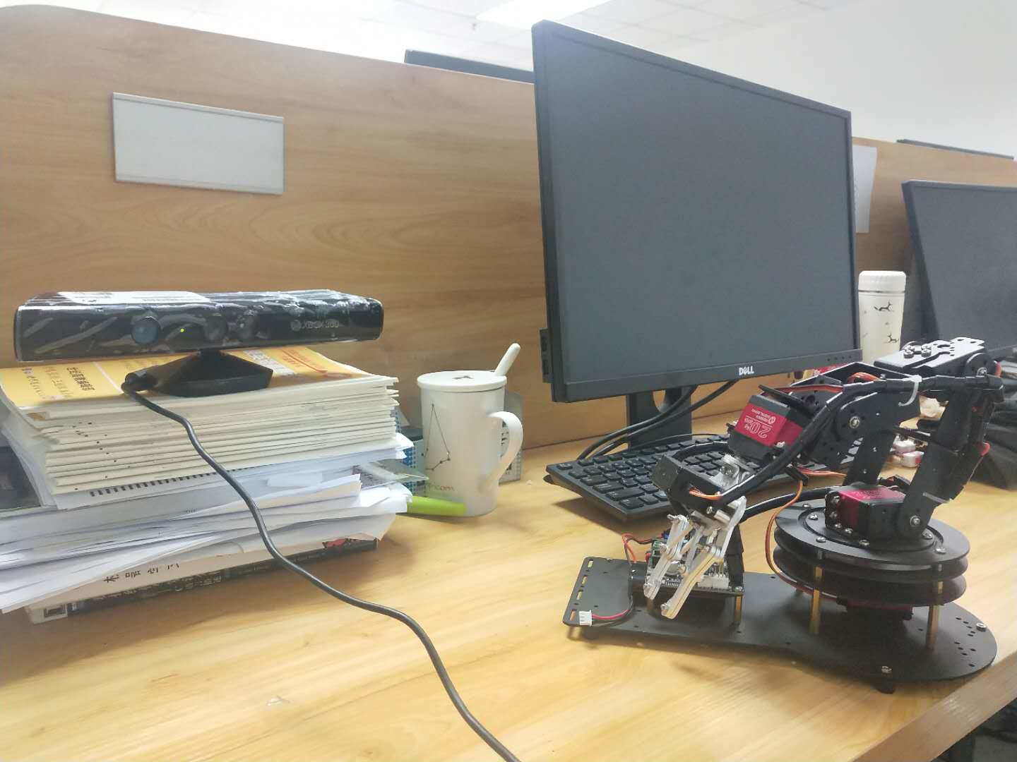
Why recognize and locate?
My job recently: goal is to use our depth sensor to let our robotic arm have the ability to grab objects in 3D space.
We can see that,
The robot arm has its own coordinate system, but it cannot recognize and locate the objects.
Kinect depth camera has the ability to recognize and locate.
How can we combine these two things together?
x
y
z
x
y
z

Slide 4
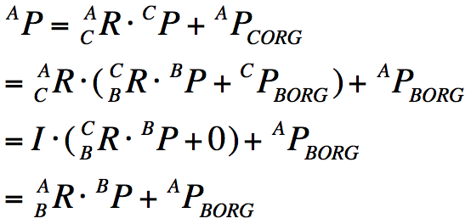
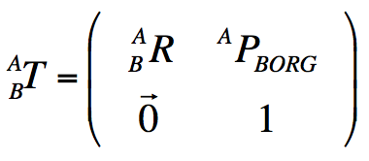
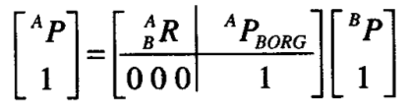
Why recognize and locate?
we can use a homogeneous transformation matrix with a rotation matrix to describe the coordinate transformation.
Position in Kinect
Position in arm
We need to recognize the object and get its position in 3D world

Slide 5
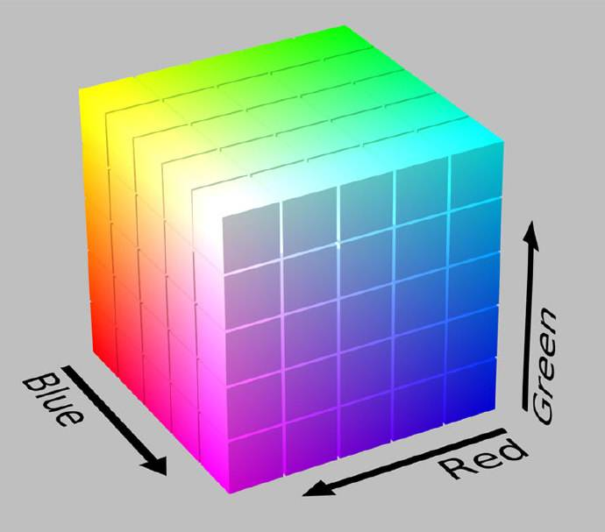
Method to recognize a special object
The first method, color processing based on opencv.
RGB color space
A picture is described as
Cows*Columns*Channels
There are three channels in each pixel, which store RGB values, each value is a byte(8 bits)
Black[0, 0, 0] White[255, 255,255]
Blue[255, 0, 0] Green[0, 255, 0]
Red[0, 0, 255]
This is not in line with the people’s thinking model

Slide 6
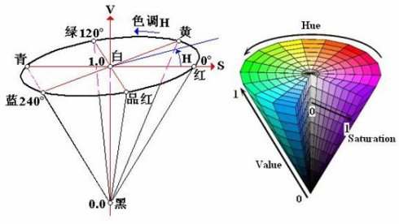
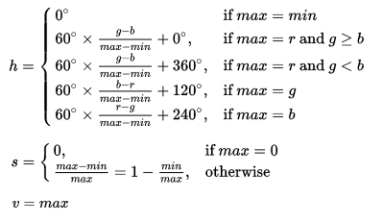
Methods to recognize an special object
HSV color space
HSV : Hue (色相), Saturation（饱和度）, and Value（明度), it tells us,
What colour is this?
How deep is the color? Light or dark?
How about the brightness of the color
This color space is very close to the people’s thinking way
RGB
HSV
Opencv::COLOUR_RGB2HSV

Slide 7
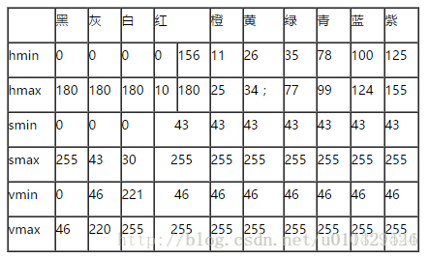
Method to recognize an special object
After the conversion, we can operate the color according to the following table.
By operation, adjust the range value. we can
get the binary image（二值图像）,.
Binary image is a grayscale image（灰度图）
only one channel in each pixel, the color of object we want to locate is marked as [11111111], background is maked as [00000000]
The binary images can easily help us get the position of the object of the specific color in the image.
Advantege and disadvantege of this method?
Rejected!

Slide 8
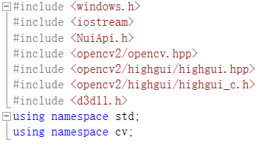

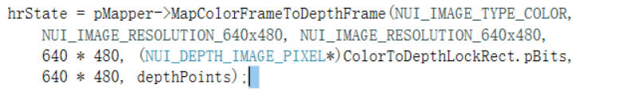
Method to locate an object in 3D word.
After we get the position of an object in an image , how to locate it in 3D word?

Slide 9
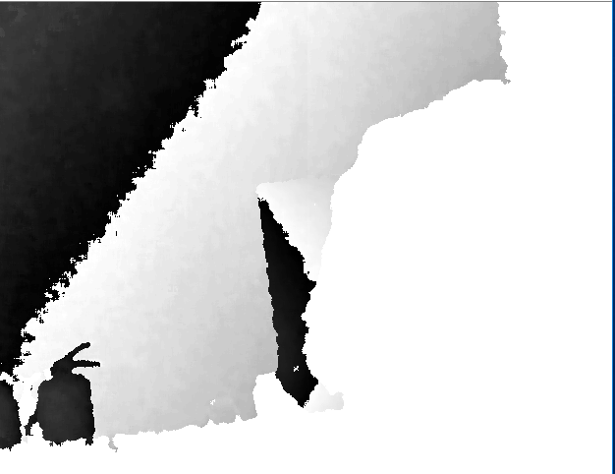
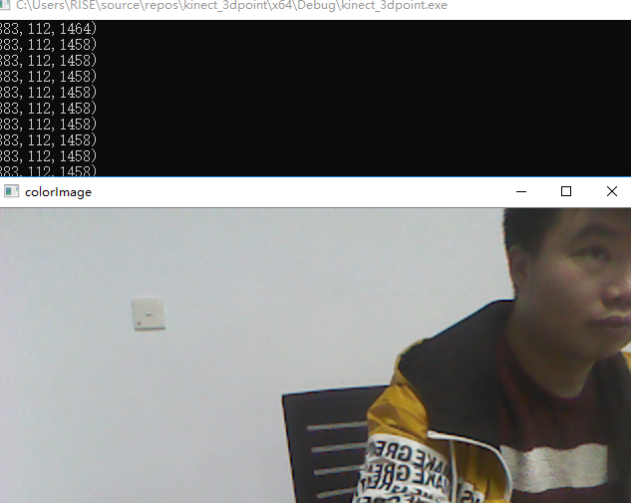
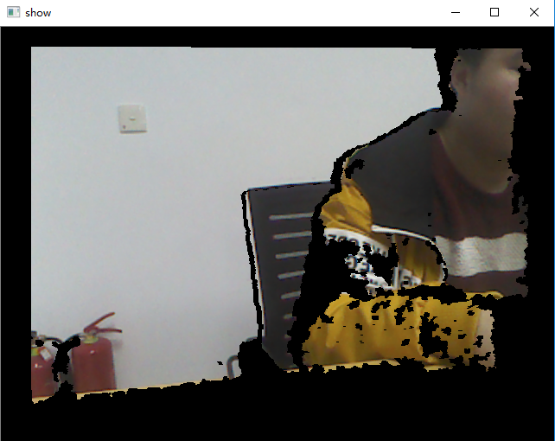
Method to locate an object in 3D word.

Slide 10
Thanks

